Slide 1
Compilation Techniques (9)
Execution environments
Machine code
Virtual machines
Stack based VM
Register based VM
Function calls
VM implementation
© Codruta-Mihaela ISTIN 2015

Slide 2
Execution environments
The goal of a compiler is to generate executable code
The executable code can be generated for a:
  microprocessor (µP): Intel, AMD
  microcontroller (µC): Atmel, Microchip
  virtual machine (VM): JVM, CLI, Dalvik
Microcontrollers – microprocessors with embedded memory, input/output interfaces such as analog and digital converters, ... From a compiler point of view they are treated as microprocessors
Virtual machines – abstract execution environments (instruction set, memory & stack management, standard library) which do not correspond to an existent hardware (in some cases µP or µC were designed to directly execute VM instructions):
  JVM – Java Virtual Machine
  CLI – Common Language Infrastructure (used in .NET Framework)
  Dalvik – used in Android
© Codruta-Mihaela ISTIN 2015

Slide 3
Machine code
The machine code (MC) is the µP native language. It is the lowest-level interface to hardware, so it allows full control for all the µP resources, at their maximum speed
Compilers which generate MC: C, C++, Fortran, Ada, Pascal, …
The main advantage of MC generation is that the generated code has the maximum possible speed on a specific µP
Disadvantages of MC generation:
  The code runs only on a class of µP (ex: Intel/AMD x86 compatible µP)
  If a class of µP has newer members with enhanced instruction sets (Intel/AMD SSE, AVX) and if for backward compatibility the compiler generated code does not use these instruction sets, the generated code will not fully use the µP
  Because for most µP the instruction set has strict limitations (small number of registers, non-orthogonal instruction set, …) the compilers which generate MC are in many cases more complex than the ones which generate code for VM
© Codruta-Mihaela ISTIN 2015

Slide 4
Virtual Machines (VM)
A VM defines an instruction set and its associated execution environment (memory & stack management, standard library, …)
Compilers which generate VM code: Java, C#, PHP, Python, Ruby, …
A code generated for a VM can run on any platform (µP and operating systems) which implement that VM
VM code can be smaller than machine code so it is more suitable for network and for resource constrained systems
The main disadvantage of VM code is that it is slower than machine code, because it requires an intermediate layer of decoding and execution
When most of the job is done in VM standard library, the speed is about the same as the machine code (ex: a JavaScript program which uses regular expressions has about the same speed as a C program which uses the same regular expression library)
© Codruta-Mihaela ISTIN 2015

Slide 5
VM → MC code generation
For speedup VM code can be translated to MC. In this way the full speed of the µP is available
Because the generation is made on the same machine on which the code is run, VM knows all the µP capabilities (extended instruction sets such as SSE, AVX) and the generated code can use the µP at its maximum potential
JIT (Just In Time) compilers – translate the VM code just before its execution. The translation time is important (ex: a web page must be run as quick as possible) so only basic code optimizations are performed
AOT (Ahead Of Time) compilers – translate the VM code with full optimizations and keep the translated code in a cache. When the code is run again its MC is taken directly from cache. AOT allows extensive optimizations and they are suitable for many usages, because most users use only a small number of applications or web sites (ex: from Android 4.4)
© Codruta-Mihaela ISTIN 2015

Slide 6
Execution environment
Besides an instruction set, a VM must also provide some functions:
A garbage collector for languages with automatic memory management (Java, C#, PHP, JavaScript, Python, Ruby) – it automatically frees the memory that is no longer used in program
A possibility to interface with native (machine code) functions that are provided by the operating system or by the VM itself (ex: functions for file/directories management, network, display, …)
Every VM must provide some standard libraries and maybe some operating system specific functions.
Possibly a way to store programs compiled to that VM (ex: .class files for JVM)
Other common facilities: debugger (with step by step execution, breakpoints, memory and stack visualization, …), profiler (with capacity to measure the execution time for different functions or instruction blocks)
© Codruta-Mihaela ISTIN 2015

Slide 7
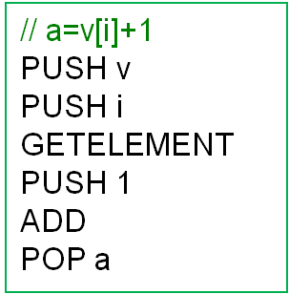
Stack based VM (SVM)
Stack – an abstract data type that defines a collection with two operations: PUSH – adds an element to collection and POP – retrieves and removes an element from collection. The retrieval is done in the reverse order of the addition (LIFO – Last In First Out). VMs also defines other stack operations such as indexed access (accessing an element that is not the top of the stack).
SVM uses a stack for all its arithmetic operations, function calls and for most of the memory transfers
SVM examples: JVM, CLI
PUSH v
v
PUSH i
v
GETELEMENT
v[i]
i
PUSH 1
v[i]
ADD
v[i]+1
POP a
1
© Codruta-Mihaela ISTIN 2015

Slide 8
SVM properties
Because the stack is implicitly used for many operations, these operations do not require supplementary arguments, so the code can be very compact (ex: ADD does not require any operands because these are the last two stack values and also the result will be stored in stack)
Function calls can be implemented as stack operations: the arguments are pushed on stack, the function is called and it replaces the arguments with the result
Memory moves are implemented as stack operations: a memory value is pushed on stack and popped at another memory location
Stacks are simple data structures so they can be implemented efficiently using vectors
For STL the operations must specify data type (ex: ADDI for integers or ADDR for reals)
For DTL there is only one operation code (ex: ADD) and the data type is stored in its operands
© Codruta-Mihaela ISTIN 2015

Slide 9
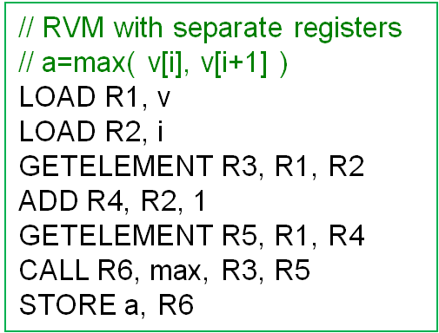
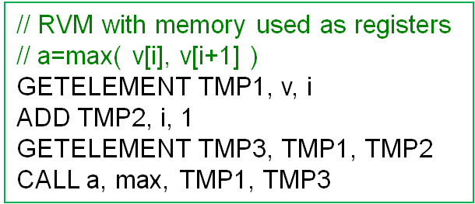
Register based VM (RVM)
All arguments and results are stored in special locations named registers or directly in memory. In the latter case, any memory location is considered a register
There can be a finite or infinite number of registers. In the case of finite number, code generation for complex expressions must be done in such way that only the existent registers are used (for example by using auxiliary memory locations)
RVM examples: Dalvik, Lua
© Codruta-Mihaela ISTIN 2015

Slide 10
RVM properties
It requires less instructions than SVM (ex: for “a+b” SVM needs 3 instructions but RVM only 1)
It requires less memory accesses than SVM (ex: for “a+b” SVM needs 7 memory accesses (get “a”, put it to stack, get “b”, put it to stack, get “a” and “b” from stack, put the result on stack) but RVM only needs 3 (get “a” and “b”, put the result) )
RVM instructions have explicit operands which specify both sources and destination, so the instructions require more bytes than SVM
A study (Yunhe Shi, David Gregg, Andrew Beatty, M. Anton Ertl, “Virtual Machine Showdown: Stack Versus Registers”, VEE’05, ACM) translated JVM bytecodes (SVM) to a custom RVM. The results were: elimination of 47% executed instructions, the bytecode size 25% larger, 32.3% less execution time.
© Codruta-Mihaela ISTIN 2015

Slide 11
Function calls (1)
Activation record (AR) – (sometimes named “stack frame”) all data required for a function call and run: arguments, the return address, local variables, context pointers (ex: this)
When a function is called the following actions are performed:
  the call arguments are pushed on stack
  the return address (the one after the call instruction) is saved so it can be restored after the function run
  the execution is transferred to the function starting point
  The function reserves space for its local variables
After the function ends all the AR data is removed from stack, the return value is put on stack and the execution is transferred to the saved return address
Variations: the AR is made using dynamic allocated memory not stack; the calling parameters and/or return value are passed by registers (ex: Intel/AMD x64 calling convention specifies specific registers for calling arguments and return value)
© Codruta-Mihaela ISTIN 2015

Slide 12
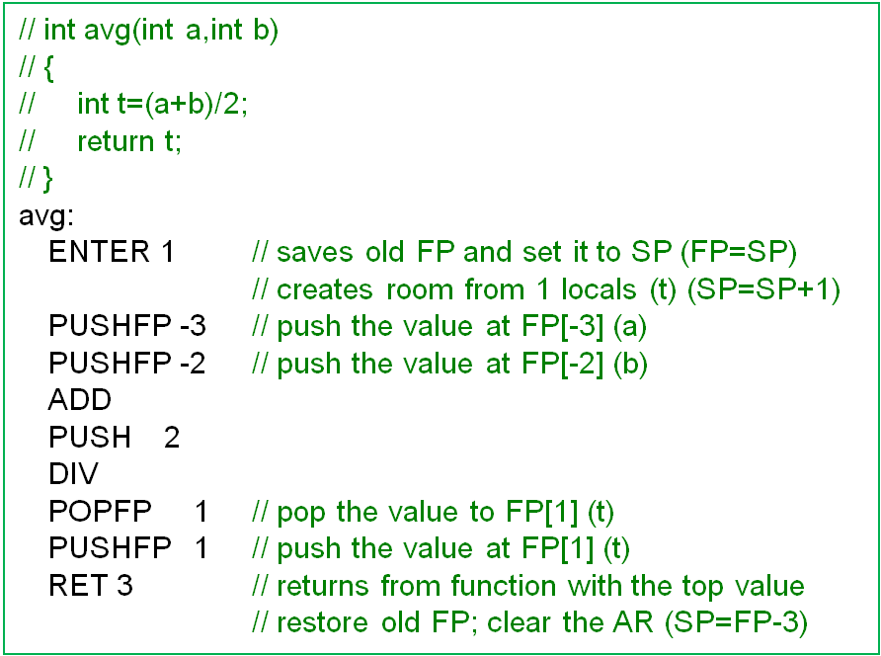
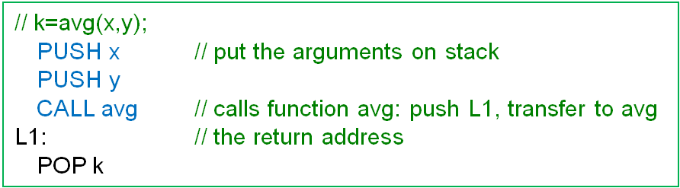
Function calls (2)
Activation Record
a
b
L1
FP →
old FP
SP →
t
…
SP →
(x+y)/2
© Codruta-Mihaela ISTIN 2015

Slide 13
VM implementation (1)
An instruction has an instruction code (opcode) and possibly some arguments
The opcode and arguments can have a fixed number of bytes or they can use only some bits in order to reduce size
The interpreter has a pointer to the current instruction (IP – Instruction Pointer)
Instruction execution:
  The opcode is loaded from IP and decoded. If it has parameters these are also loaded
  The instruction is run
  The IP is updated to point to the next instruction to be runned (not necessary the next one in memory in the case of jumps and calls)
Native calls (calls to VM or OS provided functions) can be implemented with function pointers (C/C++) or with interfaces (Java)
© Codruta-Mihaela ISTIN 2015

Slide 14
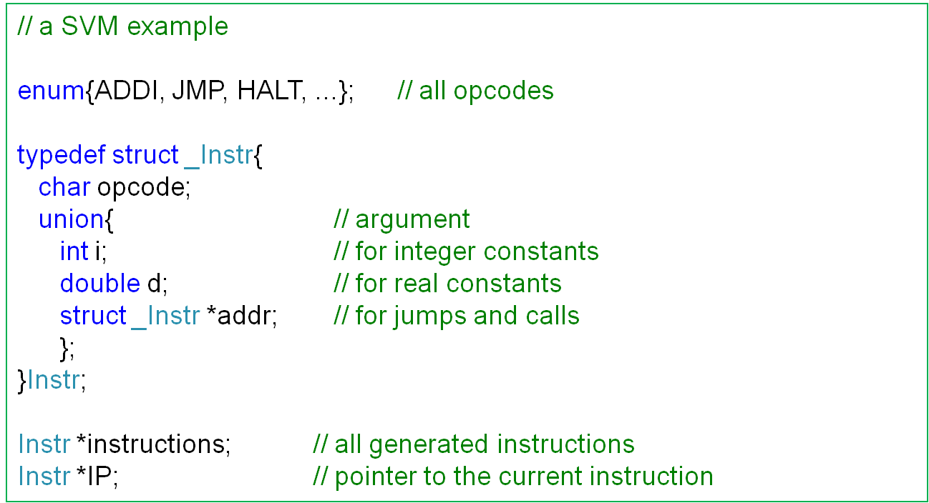
VM implementation (2)
© Codruta-Mihaela ISTIN 2015

Slide 15
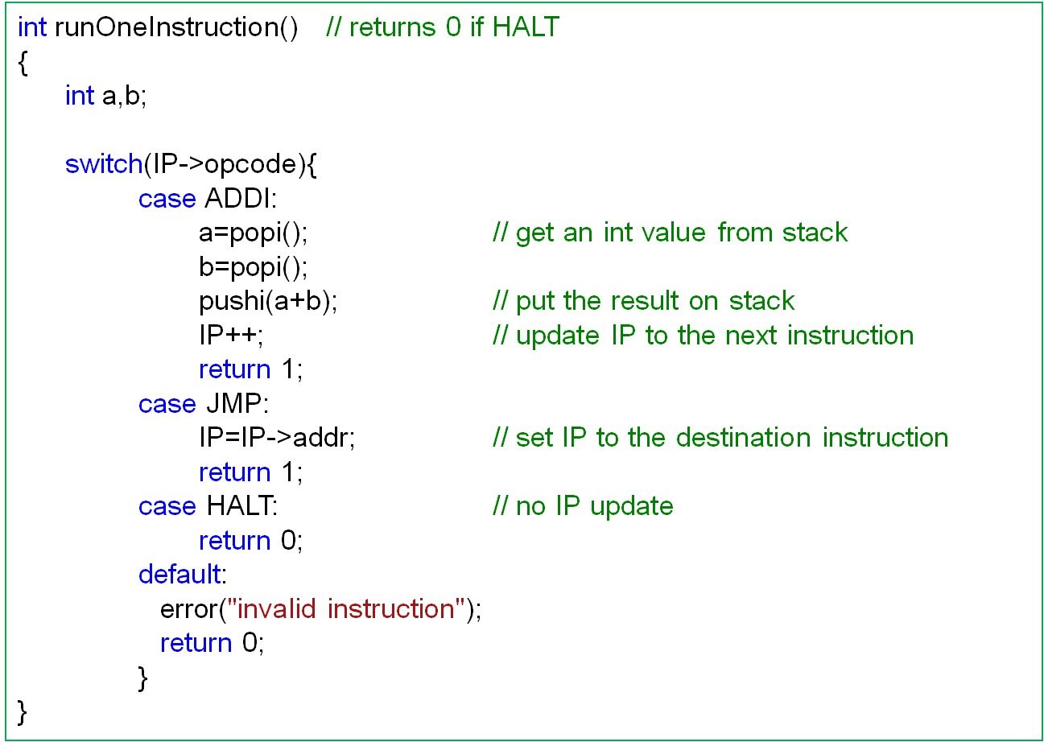
VM implementation (3)
© Codruta-Mihaela ISTIN 2015

Slide 16
Bibliography reading
Compilers. Principles, Techniques and Tools
7.1, 7.2, 7.3, 7.4, 7.5
© Codruta-Mihaela ISTIN 2015

